Slide 1
Hello Friday Night at the ER facilitator. Please read these points before using these (Microsoft PowerPoint) slides:
This slide set goes with the program described in the Guide for Facilitators.
Before a program, while setting up game tables, you may display the Setup slide for reference. It’s one of the few slides that have been tagged as “Hide Slide” during a Slide Show.
If you print from this file, choose whether to include or exclude “hidden slides.”
During a program you must use these slides in Slide Show view to enable animation effects that provide important sequencing of information.
Refer to Notes, provided with each slide, for certain how-to information and for suggested remarks. Refer to the Guide for Facilitators for detail.
Please modify this presentation – hiding certain slides or editing them – to meet your needs. Retain the original file and save with a different name if you make changes.

Slide 2
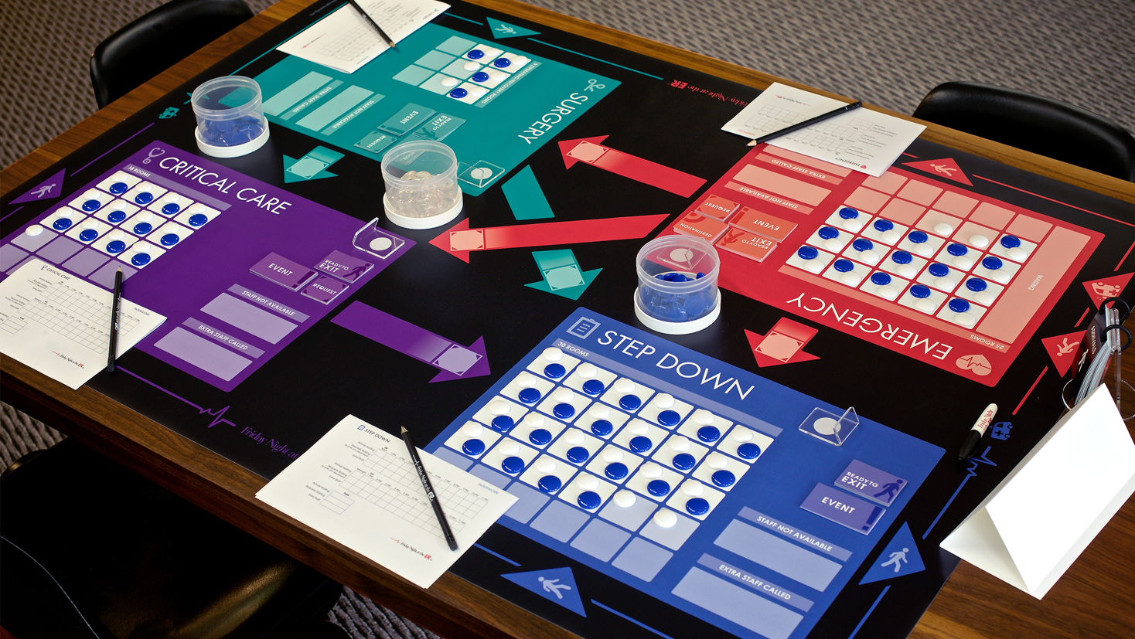
Setup
Notes:
[For reference while setting up tables before a program]

Slide 3

Welcome
Sit anywhere
With people you don’t normally work with
4 per table
Notes:
[Display before the start of the program, while people are arriving]

Slide 4

Notes:
[Introduce people and the program]
In today's program we will use the Friday Night at the ER game as a learning tool. This is a simulation game. We will play the game, take a short stretch break, and then talk about the experience and what it means.

Slide 5
Agenda
Introduction
Play game, calculate scores
Stretch break
Debrief: the experience; the learnings; the application

Slide 6

Why play a game?
Notes:
Why are we spending time today playing a game?
For one thing it’s fun.
It also provides us with a shared and memorable experience that we can refer back to.
Moreover, a simulation game such as Friday Night at the ER is an “experiential learning” opportunity, and people learn well by experience.

Slide 7
Experiential Learning
Mental Models
Results
Simulation
Decisions
Actions
Notes:
Experiential learning is ‘learning by doing.’
This is a classic learning-by-experience diagram. It’s a feedback loop, that starts with Mental Models.
We all hold in our minds Mental Models - ideas and assumptions - that influence our Decisions about what to do and how to behave, and we implement our decisions by taking Action.
Then, if we notice Results about the consequences of our actions, then we then have the opportunity to learn, to adjust or enhance our Mental Models…completing the feedback loop and enabling us to make better decisions that are more likely to produce intended results.
This learning loop works best when we can iterate around the loop quickly – seeing the results of our actions and getting the chance to try again. It’s learning by experience. We touch a hot stove, we get quick results with a simple cause-effect connection, and we just need to go around once to effectively learn. A child learning to walk goes around this loop many times to master more complex dynamics.
Why is it difficult to learn in our work environment? We work within complex, dynamic systems, where there are often delays [CLICK] between the time we make a decisions and the time we complete actions.
Or [CLICK] between the time we act to implement a new initiative and the time we gather data to see its consequences….if we ever get data to learn whether our action produced the intended result.
This is where [CLICK] Simulation adds value. If we can simulate key attributes of the processes we manage, we can bypass the time delays and conditions that obscure our ability to see results.
In a simulation, we can compress time and space, so we can see the consequences of our actions.
We can complete the learning loop, and we can iterate around the loop many times, to effectively learn by experience.

Slide 8
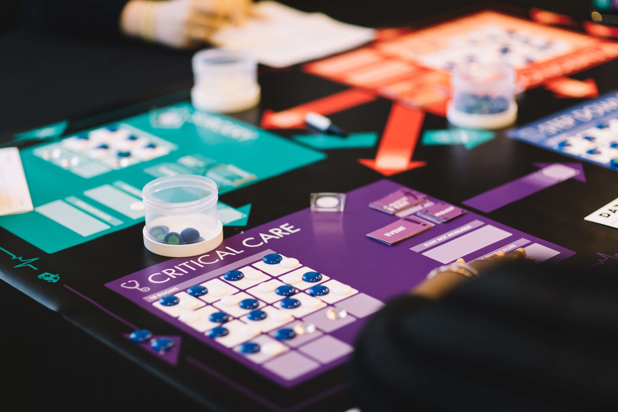

The Gameplay
Notes:
Now let’s get right into the game play.
You will each play the role… [present player instructions as shown in the Guide]

Slide 9
Hello Department Managers…
Notes:
[These 3 slides — from ”Hello Department Mangers” to “Learning Your New Job” — are designed to be paired with the 19-minute video instructions for the game play, which can be found in the Downloads section of the Support Center (https://support.fridaynightattheer.com). Alternatively, you may deliver the instructions orally, from memory or by reading the script starting on page 14 in the Guide for Facilitators. In this case, skip the notes below and the next two slides.]
Today, you will each play the role of a department manager in a community hospital…
[If you want to level the playing field among participants, you could say something like “So, leave your regular job title at the door this morning, and try to engage in this experience as a hospital department manager.”]
...In a couple of minutes, I will share a video that will give you all the information you need to play the game and then you’ll proceed to play on your own for about an hour. Then, after the gameplay and scoring, we will take a short break; then we’ll be back together as a group to talk about the experience.
But before we get to any of that, your hospitals will need names… [Proceed to next slide]

Slide 10
Your first task as managers
Name your hospital:
Take one minute to come up with a hospital name
Write it on the name card using the marker pen
Notes:
Your first task as managers is to take the blank card and the marker at your table and come up with a name for your hospital.
Go ahead now at each table and take about one minute to come up with a name and write it on your card.
[When they’re done] Okay, can each hospital team introduce yourself—just speak up and tell us the name you've chosen as I point to your table. ....[Point to one at a time to hear their names].... Thank you!

Slide 11
Learning your new job
Pay close attention to the video
Be prepared for hands-on practice
Hold your questions
Notes:
Now, it’s time to learn your new jobs for the next hour. This video (19 minutes) will give you all the information you need and it includes some hands-on practice. So pay close attention, be prepared to follow along at your tables, and hold your questions until the end.
If you miss something in the video, don’t worry about it. You’ll be just fine if you continue to pay attention and try to follow along. After the video, if you still have a question, raise your hand and at that time I will come to your table to answer.
[Play the video instructions]
DURING THE VIDEO
[While the video is playing, your role is to ensure that participants are paying attention. If participants are talking at tables, ask them to hold their conversations. If someone has a question, assure them that you will answer any questions during the gameplay. In the final minutes of the video, consider handing out the one-page “Instructions Summary” (one per table). This optional resource gives players an easy visual to refer to that summarizes the instructions in the video. If you hand out this resource too early, it may distract participants from the video.]
AFTER THE VIDEO
[Begin speaking as soon as the video ends so that participants don’t have a chance to ask questions, which may become spoilers in front of the group]
....Hopefully you were able to take in those instructions. Like you heard in the video, things will become more clear as you settle into your role and I’ll be available to answer your questions.....
{Display and point to the “5 Steps Each Hour” slide}
....Now go ahead and finish the 1 PM hour, and then move on to repeat the five steps for Friday 2 PM and beyond.

Slide 12

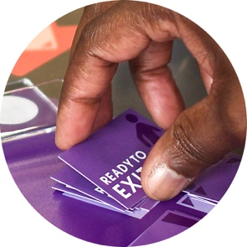
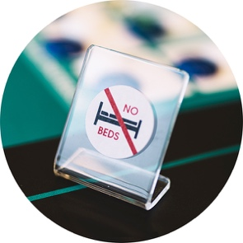
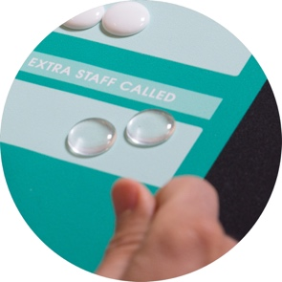

Steps Each Hour
Arrivals
Exits
Closed?
Staffing?
Paperwork
Notes:
[Show this slide during instructions when explaining Steps Each Hour. This slide is displayed for player reference during the entire game play.]

Slide 13




New Challenge:
Reorganize!
Stand up and move to the department on your left
Notes:
[Optional to show this slide if you interrupt the game play for this announcement.]
Can I have your attention please? I’ve just received the memo from the corporate office that we are going to reorganize!
You may quickly finish the hour you’re in, then everyone stand up, move to the department on your left, be seated, and resume the game play.
[Go back to display the Steps Each Hour slide]

Slide 14

New Challenge:
Research!
Surgery Managers,
search for best practices in the field and report back
Notes:
[Optional to show this slide if you interrupt the game play for this announcement.]
Can I have your attention please? Would all Surgery Managers please stand up, silently walk around the room to search for best practices and return to your table to share anything you might have discovered.
[Go back to display the Steps Each Hour slide]

Slide 15

New Challenge:
Divert!
If closed, send your ambulance arrivals to another hospital’s Emergency department
Notes:
[Optional to show this slide if you interrupt the game play for this announcement.]
[See full instructions in the Guide for Facilitators starting on page 22]
[After reading your script, go back to display the Steps Each Hour slide]

Slide 16
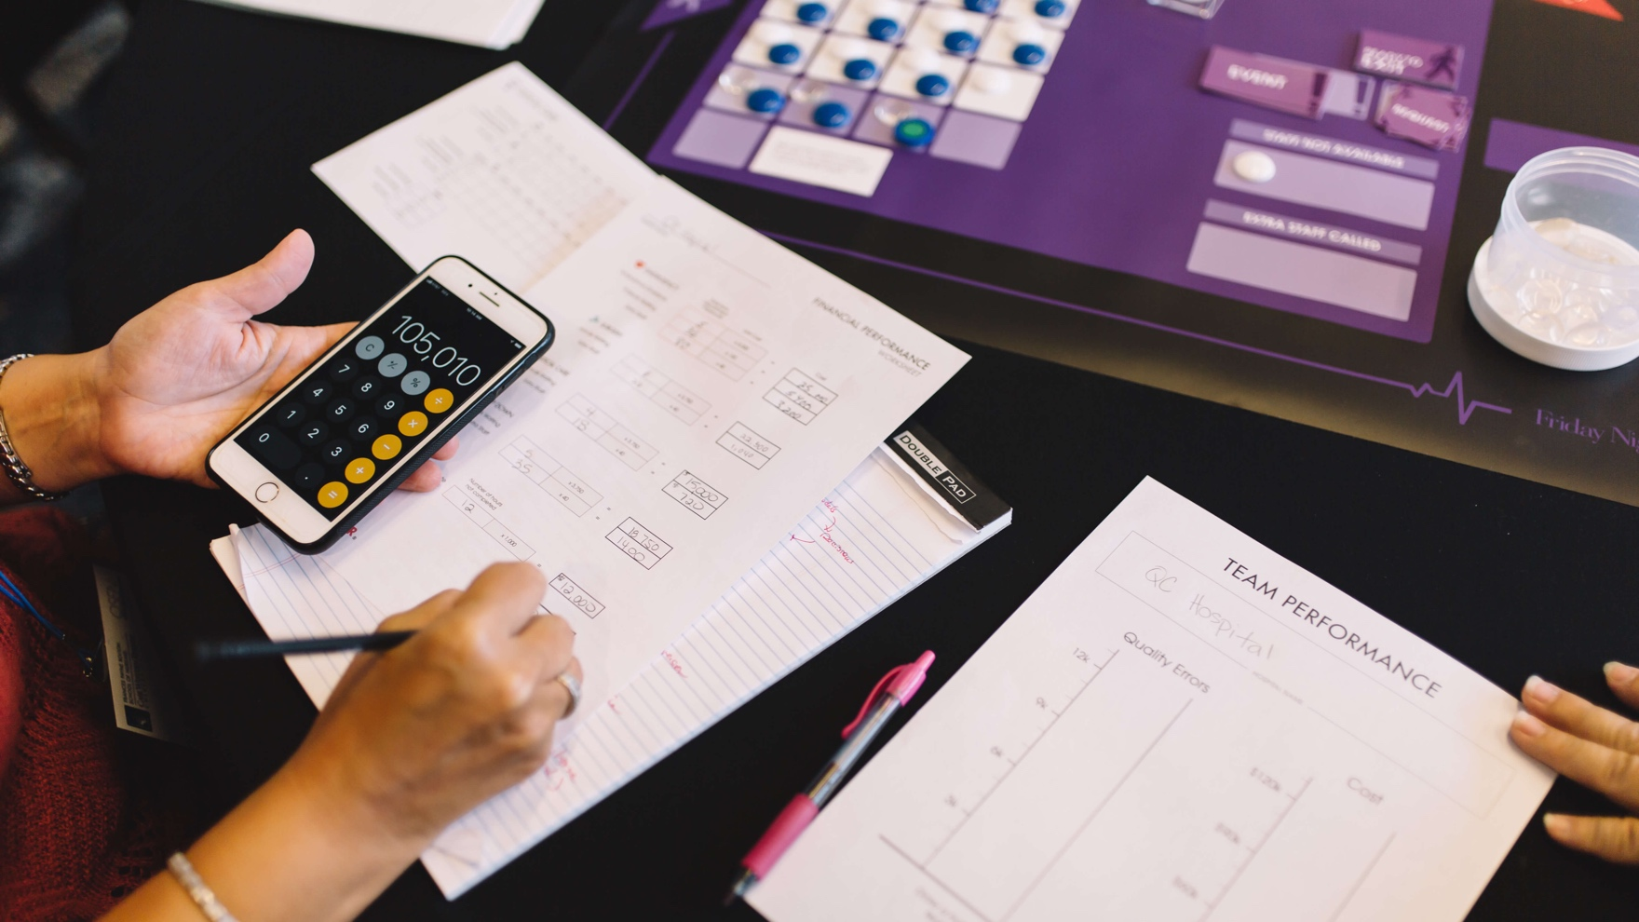
Calculate your scores
Complete your department Paperwork
Complete 2 worksheets: Financial and Quality
Post totals for the team on the Team Performance Chart
Notes:
[Show this slide when the game play is completed for all or most tables]

Slide 17
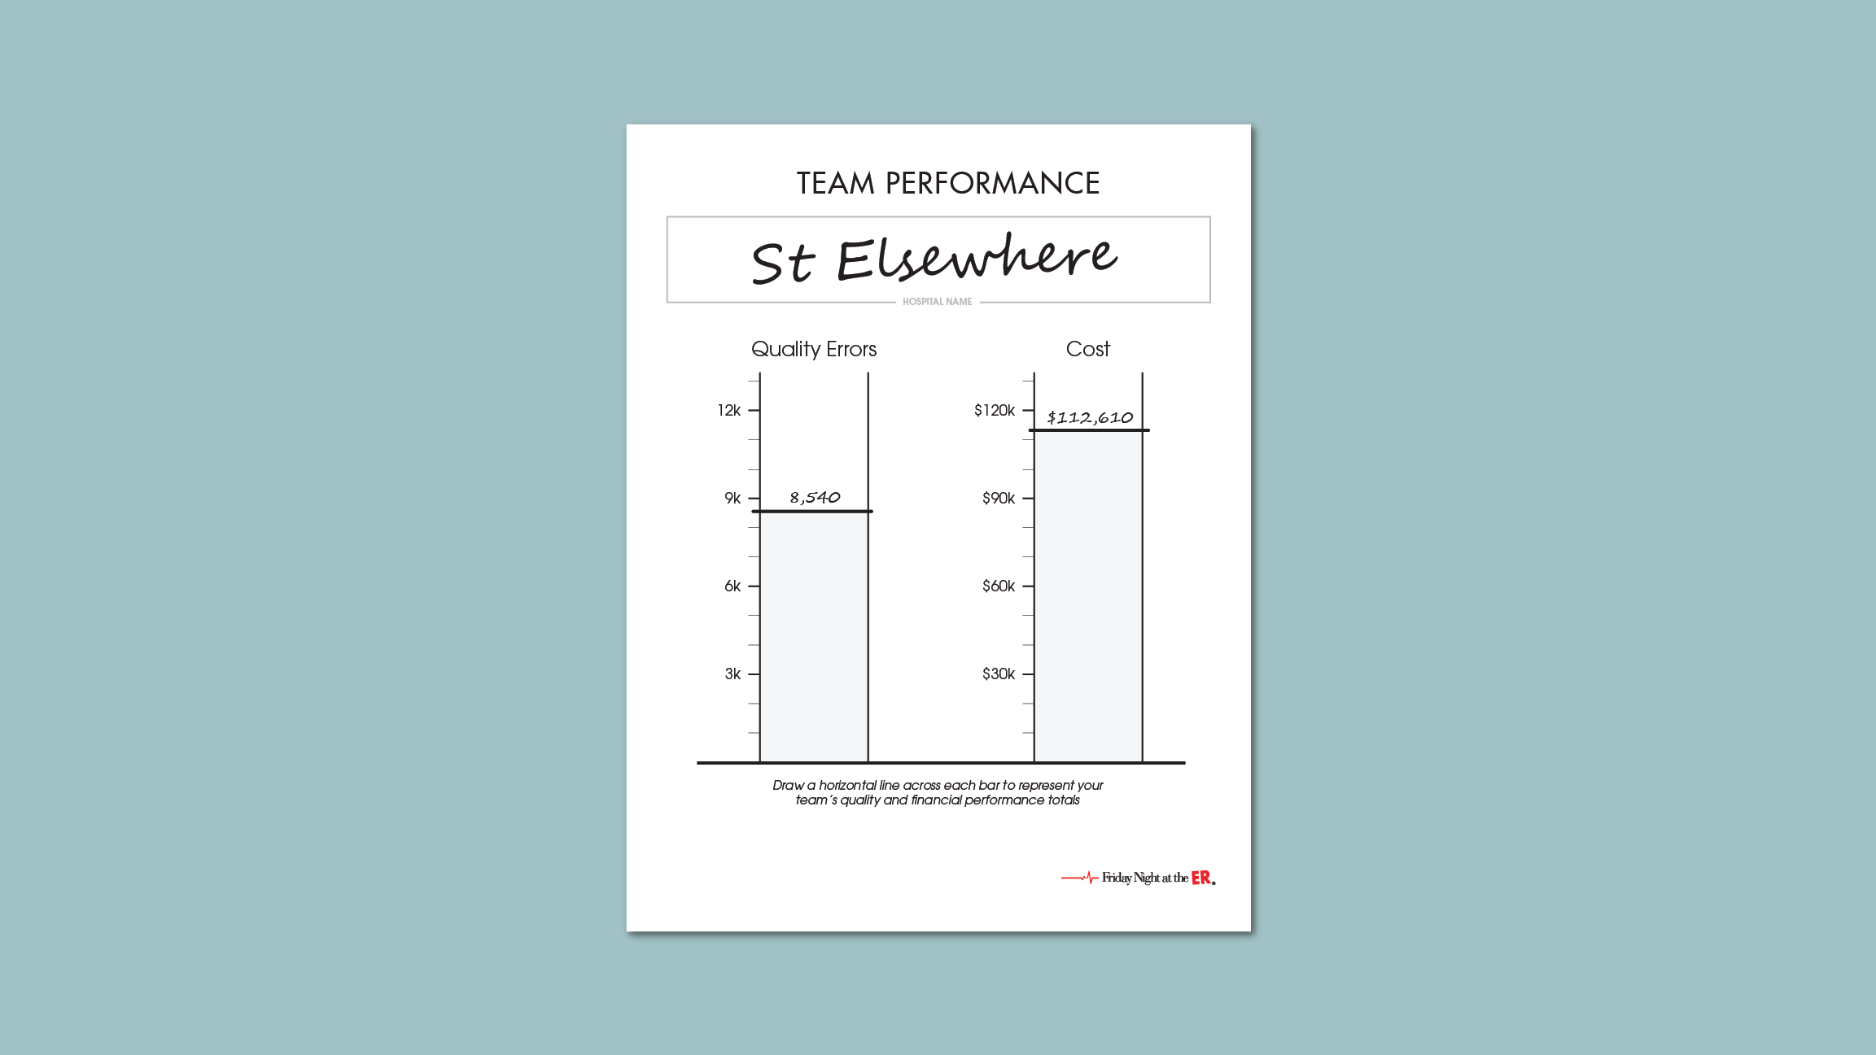
How to complete the chart
Notes:
[Optional to show an example for completing the Team Performance chart]

Slide 18


Reflecting on
the Gameplay
Notes:
[Show this slide as participants return to seats and when you are ready to resume the program]

Slide 19
Team Dialogue
What felt real?
What drove your behavior?
Core strategies for improvement?
Notes:
First, spend about 10 min in your teams answering these three questions. Someone should take notes, because I will ask about your responses.

Slide 20
What felt real?
Notes:
[Leave Slide Show view to enter responses on screen.]
Even though this was just a game, much about the experience felt like our real work processes.
Example responses:
Time pressure
Having to respond to events / put out fires
Uneven workloads
Uncertain demand
Worry about department expenses
Depending on others
Not having enough information
…

Slide 21
What drove behavior?
Notes:
[Leave Slide Show view to enter responses on screen.]
What drives our behavior may include values, assumptions, data, and policies.
Example responses:
Not letting patients wait too long
Keeping costs down
The “rules”
Following a plan
The Data card
The No Exits card in Step Down
…

Slide 22
Strategies?
Notes:
[Leave Slide Show view to enter responses on screen.]
We will consider these strategies as we go on to reflect about the game and what it means.
Example responses:
Have a shared vision
Share resources
Send staff to where the need is greatest
Double up in rooms
Treat patients in the waiting area / unused spaces
Use the data
…
[The Back button in the lower left corner may be used later in the slide presentation to briefly revisit this slide.]
[Resume Slide Show view.]

Slide 23






The parts are interdependent
Who is responsible for Emergency waiting?
Notes:
Let’s step back and look at the big picture of what was happening in the game play.
You were each responsible for a part of the system, but no one part stood alone. For example:
A big increase in flow into the Emergency department rippled through to other departments.
If affected departments did not add staff, then Emergency patients had to wait for transfer.
As Emergency filled up, arriving patients had to wait to get in.
Patients waiting to get in led to pressure to divert ambulance arrivals
And then the whole hospital paid the price, because diverting patients was costly.
The parts of the system are interdependent.
[CLICK]
Who was responsible in this game for Emergency waiting? (Answer: Everyone! The Emergency department alone could not solve the problem.)
And, by the way, if you could intervene just one place in this system to improve Emergency waiting, where do you think that would be? (Answer: Step Down! …because it was the only department downstream that could move patients out of the hospital.) In complex systems, cause and effect are often distant – requiring us to look upstream and downstream to identify causes of a problem.

Slide 24

Applying the Learnings
Notes:
The virtual world of the game did feel like our reality in some important ways.
The uneven demand
Handoffs from one department to another
Events that got in the way.
..and other things that you already identified.
Learnings from the game can be applied to our real work.

Slide 25
Systems Thinking
A system is a collection of parts that function together for a purpose
Systems Thinking is a discipline that includes
  Concepts, principles and knowledge
  Methods and tools
Friday Night at the ER is a tool designed to help people put core principles of Systems Thinking into practice
Notes:
The theoretical basis for the Friday Night at the ER game is the discipline of Systems Thinking. This is a discipline for recognizing the systems in which we live and work, observing how well the particular system is achieving its goals, and learning how to make adjustments for improvement.
[CLICK]
What is a system? A system is a collection of parts that function together for a purpose. We live and work within many systems: an economic system, our solar system, our family is a system, our human bodies are a system.
[CLICK]
The discipline of Systems Thinking includes
Concepts, principles and knowledge
Methods and tools
[CLICK]
Friday Night at the ER is a tool for helping people put core principles of Systems Thinking into routine practice.

Slide 26










Champions of Systems Thinking
Notes:
While you may not be familiar with Systems Thinking, it isn’t new. In fact, for years this discipline has resonated with a wide range of leading entities worldwide that have identified Systems Thinking as a key competency for leaders in the 21st Century. Among those who emphasize the importance of Systems Thinking are:
Global corporations such as Google, IBM and Shell
Prestigious schools such as MIT’s Sloan School of Management and Harvard Business School
International bodies such as the World Bank, the World Economic Forum and the World Health Organization
Various professional institutes including the Institute for Healthcare Improvement and the Project Management Institute

Slide 27
All organizations have interdependent functions
Manufacturing
Sales
Who is responsible for on-time delivery?
Assembly
Inventory
Order Processing
Delivery
Hiring/Training
Notes:
Why does systems thinking resonate so widely? Because all organizations have interdependent functions.
In the game, the hospital was a system with parts that included 4 departments, and we saw that those departments were interdependent and they functioned together to serve the needs of their customers, the patients.
Here is an example of a manufacturing company, in which the different functional parts might include Sales, Order Processing, Parts Inventory, Assembly, etc.
[CLICK]
Just like in our example of the the hospital, where we asked “Who is responsible for Emergency department waiting?”, we might ask here, “Who is responsible for on-time delivery?” The answer, of course, is not just the Delivery function or the Assembly function…every part plays a significant role, all the way back to the Sales people who promised a delivery time in the first place. Again, the answer is, “everyone is responsible.”

Slide 28
Excellence of the parts is necessary
…but not sufficient
Notes:
As we go about our work, we must be attentive to excellence. Is excellence of each part necessary? Yes! Is it sufficient to ? No!
[CLICK]
We must optimize the system, not just the parts, if we want our companies to perform well. This is a key lesson for today.

Slide 29

Optimize the system
…not just the parts.
How?
Three core strategies…
Notes:
In the game, as well as in our real world, in order to get the results we want, we must optimize performance of the system, not just focus on the parts.
[CLICK]
How do we do this?
[CLICK]
A successful approach can be summed up in 3 core strategies.
Let’s look at these one at a time.

Slide 30
Core Strategy 1: Collaboration
Systems Thinking Principle:
“The parts of a system are interdependent.”
Notes:
One core strategy is Collaboration.
It derives from a key principle of Systems Thinking: “The parts of a system are interdependent.”

Slide 31
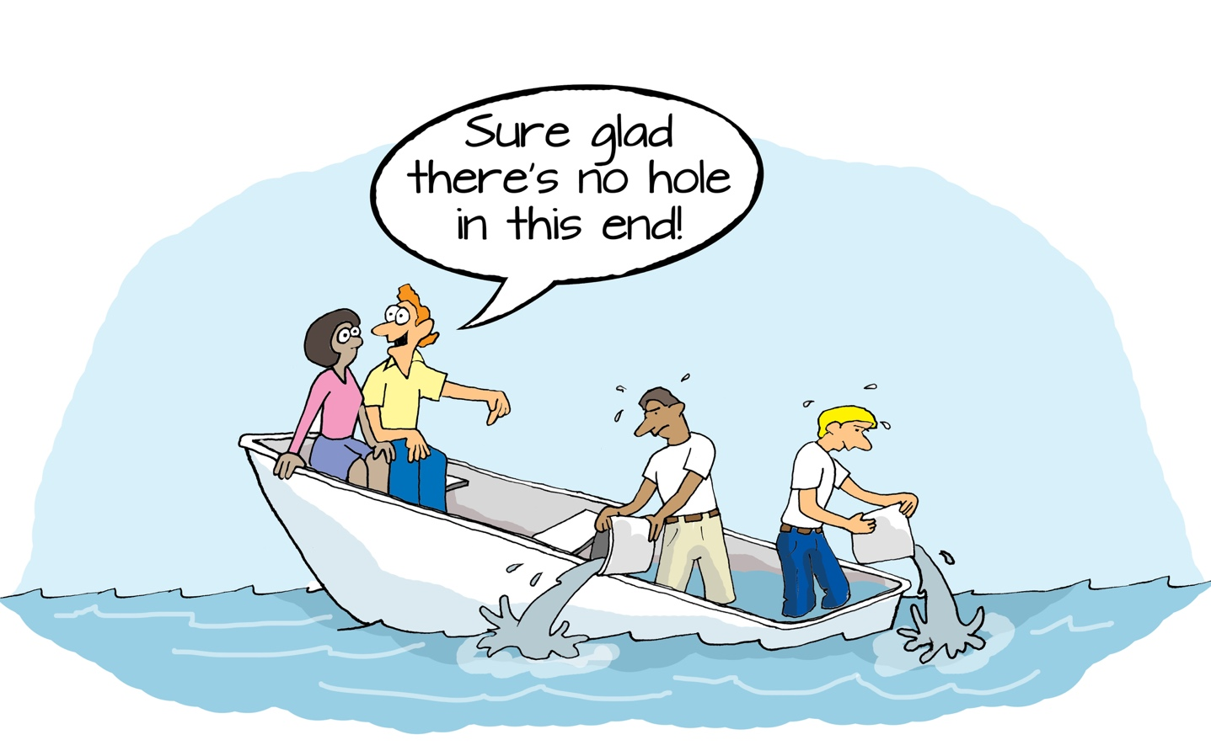
Notes:
This cartoon illustrates the inevitable failure of a non-collaborative approach!
In the game, there were uneven workloads. Emergency managers may have felt like ones working extra hard. Maybe others were thinking, “Sure glad I’m not in the ER!”
Sometimes it’s easy to forget that we’re in the same boat.

Slide 32
How to Collaborate
In the game, for example:
Manage across department boundaries
Work as a team to use and share resources (staff, space)
Apply extra support where the need is the greatest
Notes:
What does it mean to collaborate?
In the game, for example, here are some ways you might have collaborated.

Slide 33
Collaboration Ladder
High
Share Responsibility
Jointly Plan
Treat Peers as Customers
Communicate Needed Info
Low
Minimal Communication
Notes:
In any organization, what does collaboration look like? A useful tool is this Collaboration Ladder, which helps us become explicit about what we mean by collaboration.
Often people consider the lower rungs on the ladder as collaboration. [CLICK to move up the ladder]
But we need to be willing and able to move up the ladder to achieve high-level organization performance.

Slide 34
Barriers to moving up the Collaboration Ladder
High
Share Responsibility
That’s not in my job description
Jointly Plan
We compete for resources
Treat Peers as Customers
We don’t know what others need from us
Communicate Needed Info
Low
Minimal Communication
Notes:
What are the barriers in organizations that seem to prevent people from moving up the ladder? Here are some examples:
[CLICK through the 3 examples]

Slide 35
Try the Collaboration Ladder
Transfer the learning:
Identify where your organization is on the Collaboration Ladder.
What barriers seem to prevent people from moving up?
Notes:
[Distribute a copy of the Debrief Workbook to each participant and instruct them to open it to the first page titled “Core Strategy 1: Collaboration”. (The workbook can be found in the Downloads section of the Support Center at support.fridaynightattheer.com.) If you are not using the workbooks, participants can still discuss in teams and take notes on any paper you provide.]
Now, let’s transfer what you are learning from the context of the game to the context of your actual work.
First, spend about 5 minutes in your teams discussing where your organization is on the Collaboration Ladder and consider what barriers seem to prevent people from moving up to a higher level.
Then, spend a few minutes individually completing the exercise based on your own perspective. Your views may differ from the rest of your team.
Would anyone like to share? [Plan to have about 5 minutes of group dialogue.]

Slide 36
Core Strategy 2: Innovation
Systems Thinking Principle:
“Mental models powerfully influence behavior.”
Notes:
In addition to functional or departmental boundaries, there was another type of boundary that was less visible, but operating in the game play: the boundaries created by mental models, or assumptions.
[CLICK]
This leads us to name the 2nd of 3 core strategies: Innovation.
It derives from another key principle of Systems Thinking: ”Mental models powerfully influence behavior.”

Slide 37
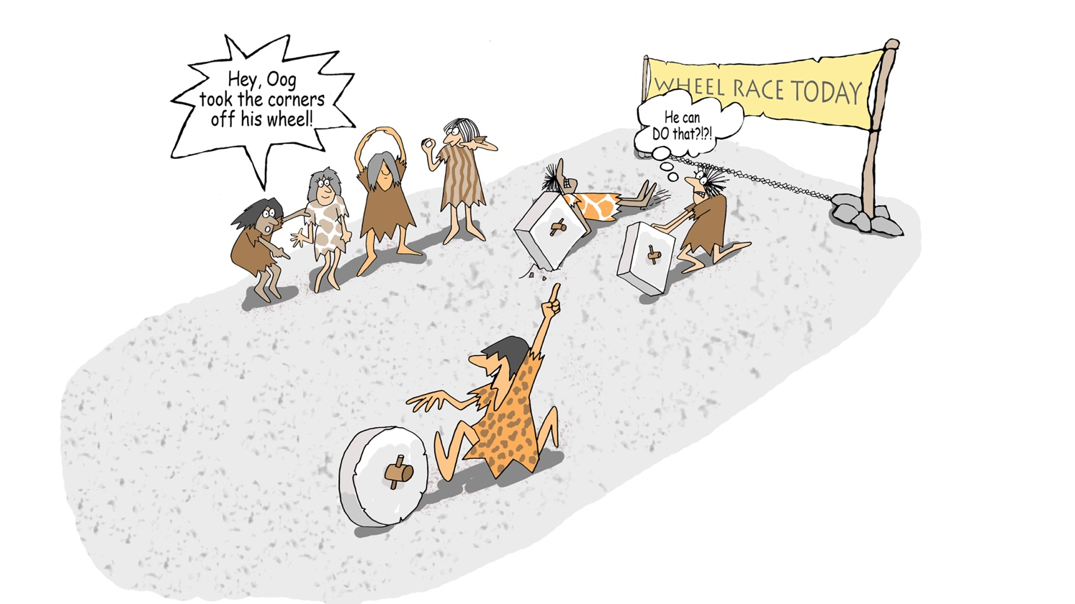
Notes:
Here we have some cavemen and women saying, “Hey, Oog took the corners off his wheel.” And a competitor thinking, “He can DO that??”
Oog happened to get past the conventional mental model of his day. He innovated, with a happy result.
And, of course, innovation is often met by surprise or disbelief by those whose mental models are bounded by established practice.

Slide 38
How to Innovate
In the game, for example:
Share staff across departments
Treat Emergency patients in the hallway, in unused Surgery space
Place 2 patients in rooms with 2 staff
Notes:
There was a similar reaction earlier when some of you said [CLICK] you shared staff across departments. “Could they DO that?” Was that “cheating”?
Think about it: I never said you couldn’t share staff. So there was no rule that you couldn’t share staff… or
[CLICK] Treat patients in other spaces,
[CLICK] or double up patients in rooms, for example.
There were no rules in the game that would have prevented you from taking these actions, so why do most people play the game as if there were such rules?
[If asked, people will typically answer, ‘I assumed we were not allowed.’] The assumptions you brought to the game play limited the possibilities that you considered.
Innovation - being open to new practices – is a core strategy for success in the game, although it often requires reaching beyond our mental models and automatic behaviors.

Slide 39
Mental Model Reverser
Limiting assumption
Possible alternative
I must manage within my department as best I can
I should request support from other departments if needed
It’s okay to keep patients waiting
It’s not okay to keep patients waiting
Notes:
The Mental Model Reverser is an exercise designed to trigger critical thinking around mental models and promote creative problem-solving. This simple exercise can catalyze a push toward innovative practice and a willingness to examine the performance-limiting “rules” (policies, practices, widely held assumptions) that should perhaps be challenged.
What limiting assumptions or beliefs could be reversed to benefit an organization? Here are some examples from the game experience:
[CLICK through the 2 examples]

Slide 40
Try the Mental Model Reverser
Transfer the learning:
Identify a limiting assumption and try reversing it.
What barriers seem to prevent people from implementing new ideas that challenge mental models?
Notes:
[Instruct your group to turn to the next page titled “Core Strategy 2: Innovation”]
Now, let’s transfer the learning for our second core strategy, Innovation.
First, take about 5 minutes in your teams to identify and discuss a mental model (assumption or belief) that could be reversed to benefit your organization and Consider what barriers are in the way.
Then, spend a few minutes individually completing the exercise based on your own perspective. Your views may differ from the rest of your team.
Would anyone like to share? [Plan to have about 5 minutes of group dialogue.]

Slide 41
Core Strategy 3: Data-Driven
Systems Thinking Principle:
“A system must be able to learn and adapt to meet its goals.”
Notes:
Finally, we come to the 3rd core strategy.
[CLICK]
Data-driven decision making.
It derives from a third key principle of Systems Thinking: ”A system must be able to learn and adapt to meet its goals.”

Slide 42
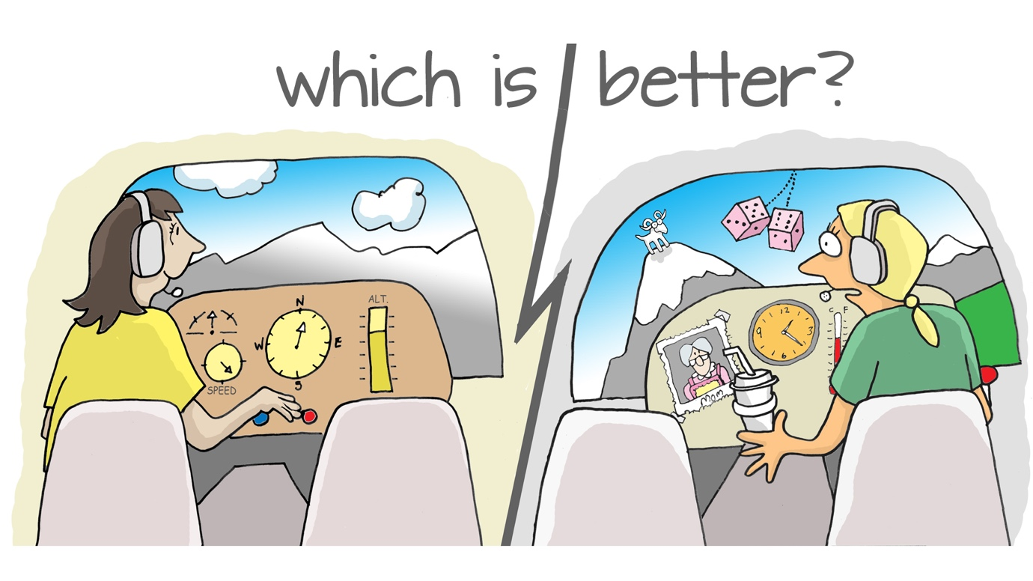
Notes:
Imagine you are flying an airplane.
Which is better? In which of these 2 cockpits are the indicators on the dashboard more useful to support you to produce the desired result?
The one on the left that shows heading and altitude and such?
Or the one on the right with lucky dice and a very nice picture of mom?
What does this have to do with our reality? It illustrates the need for a set of measurements - for feedback data - that indicate our position relative to key performance goals.

Slide 43
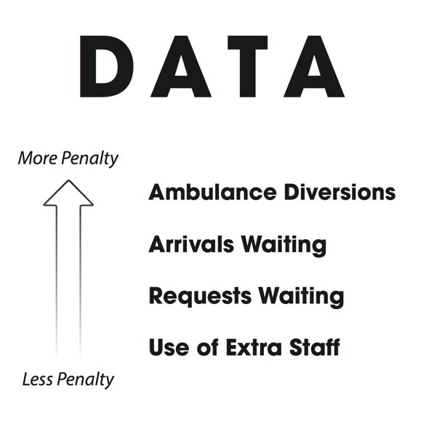
How to be Data Driven
In the game, for example:
Ask for the data to make the best decisions
Observe trends and anticipate needs
Notes:
What does it mean to be data-driven?
As you said after completing the game, had you known the data during the game play, most of you would have made different decisions about the choices you made!
[If not already discussed earlier, explain that some tables did (or no one did) ask for more information during the game play … and if you had, I would have given your table a Data card that I was holding. In some groups that play this game, most or all ask for the data; in others, no one asks. Does this reflect something about the culture of our organization? Are people accustomed to managing without much data?]
[CLICK]
In the game play, to be data driven would look like this…
[CLICK]
In our organization, what would it look like to be data driven? Do we have data on which to base day-to-day decisions? If not, should we ask for it?

Slide 44
Decision Informer
Routine decision: When Emergency is overcrowded, should I divert ambulances or call in extra staff?
Missing pieces of information:
High ratios of extra staff lead to minor quality errors; ambulance diversions severely diminish quality
Extra staff cost $40 per hour; ambulance diversions “cost” $5,000 each
Notes:
The Decision Informer is an exercise designed to shed light on the fact that big picture consequences of routine decisions are often unclear in organizations. As a result, people make decisions that improve their part of the system while unintentionally creating adverse consequences within the larger system. To optimize performance, it’s essential to use data to make decisions that align with system wide performance requirements.
What is a routine decision that impacts an organization where the choice is unclear? What missing pieces of information would be needed to better inform the choice that would lead to the best result? Here is an example from the game experience:
[CLICK through the 1 example]

Slide 45
Try the Decision Informer
Transfer the learning:
Identify an impactful decision where the choice is unclear and the missing pieces of information that could inform the choice.
What barriers seem to prevent people from using information that would inform decisions for optimal performance?
Notes:
[Instruct your group to turn to the next page titled “Core Strategy 3: Data-Driven Decisions”]
Let’s apply this now to your organization.
First, spend about 5 minutes in your teams discussing a decision that impacts the organization where the choice is unclear. Consider what information would lead to the best results and the associated barriers.
Then, spend a few minutes individually completing the exercise based on your own perspective. Your views may differ from the rest of your team.
Would anyone like to share? [Plan to have about 5 minutes of group dialogue.]

Slide 46
These 3 Core Strategies
are a Bundle
Collaboration
Innovation
Data-Driven
Notes:
We have identified 3 core strategies: Collaboration, Innovation, and Data-Driven management.
[CLICK]
These strategies are a “bundle.” That is, all three must be operative. Think about this:
An organization can be highly collaborative, but without innovation, they may just be very good at reinforcing the status quo.
Innovation without collaboration can cause havoc.
And both collaboration and innovation are meaningful only when driven by data.

Slide 47
Our Core Strategies derive from 3 Key Principles of Systems Thinking
Systems Thinking
Friday Night at the ER
1. The parts of a system are interdependent
Collaboration
2. Our mental models powerfully influence our actions
Innovation
3. Systems must be able to learn
and adapt
Data-driven decision making
Notes:
Our 3 Core Strategies actually operationalize 3 key principles of Systems Thinking.
[CLICK through the 3 principles and their corresponding strategies]
Because “The parts of a system are interdependent” therefore we must Collaborate to make sure the interdependent parts are working well together.
Because “Our mental models powerfully influence our actions” therefore we must be open to new practices and deliberately Innovate to continuously improve.
Because “Systems must be able to learn and adapt” therefore we must be Data Driven to understand how we are performing relative to changing customer requirements.

Slide 48
You essentially identified these three strategies...
Go to the list of strategy ideas
Notes:
[Refer back to the group’s strategy ideas (and you may use the “Go to..” button on the slide) to make the connection between strategies identified by participants and the broad strategies of Collaboration, Innovation, and Data Driven.]
[Then you may use the back button to return to this place in the slide presentation.]

Slide 49
Let’s see how the strategies related to team scores…
Notes:
[Refer to the gallery of Team Performance charts or your display of team game scores to ask if the best performing team(s) were collaborative, innovative and data-driven.

Slide 50
We already knew these strategies …didn’t we?
Collaboration
Innovation
Why don’t we routinely put them into practice?
Data-Driven
Notes:
Are the 3 core strategies new ideas? Most if not all of us already have heard about Collaboration, Innovation, and Data Driven management many times during our careers.
[CLICK]
Why, then, when we’re “in the trenches” – either in the real world, or a simulated world like the Friday Night at the ER game – don’t we behave as if we knew those strategies?
[Invite ideas?]

Slide 51
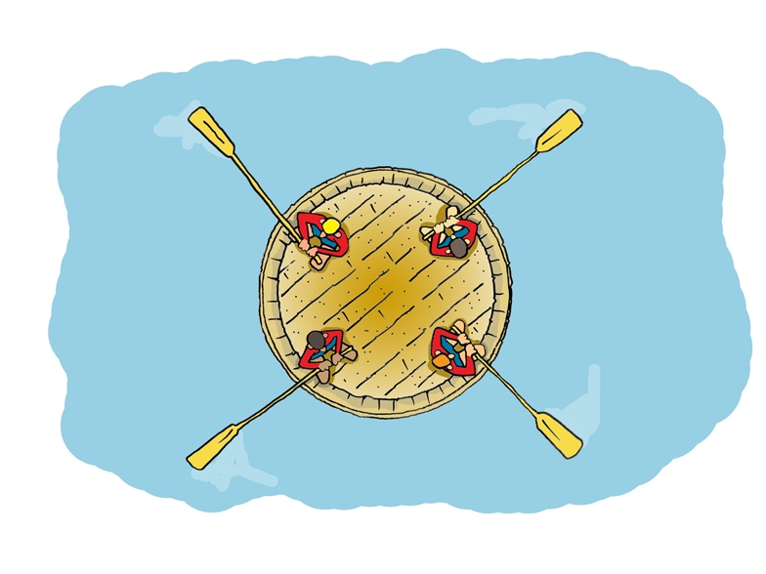
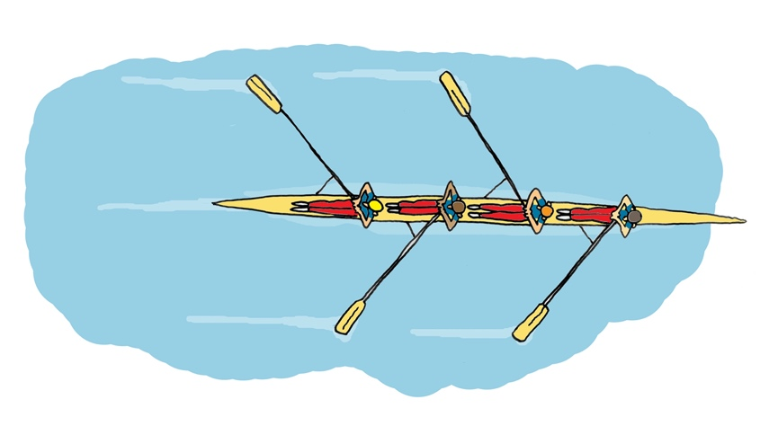
“Structure produces behavior”
Notes:
There is an axiom from the Systems Thinking field, “Structure produces behavior.”
A similar axiom from the Quality Improvement field is “Every system is perfectly designed to get the results it gets.”
It’s not necessarily that people are under-performing; it’s the structure and processes in which we place them.
Let’s look at an illustration of this point.
[CLICK]
Here is a team of rowers. They know how to work as a team. They are highly skilled, motivated, and well-practiced.
And they are operating within a structure that enables them to move quickly through the water toward their destination.
What would happen if that same team were placed in a different structure?
[CLICK]
Remember, this team is highly skilled, they are motivated, and they are well-practiced. But can they perform well to get to a destination?
It’s the structure, not the attributes of the individuals, that determines the “behavior” of this system.

Slide 52
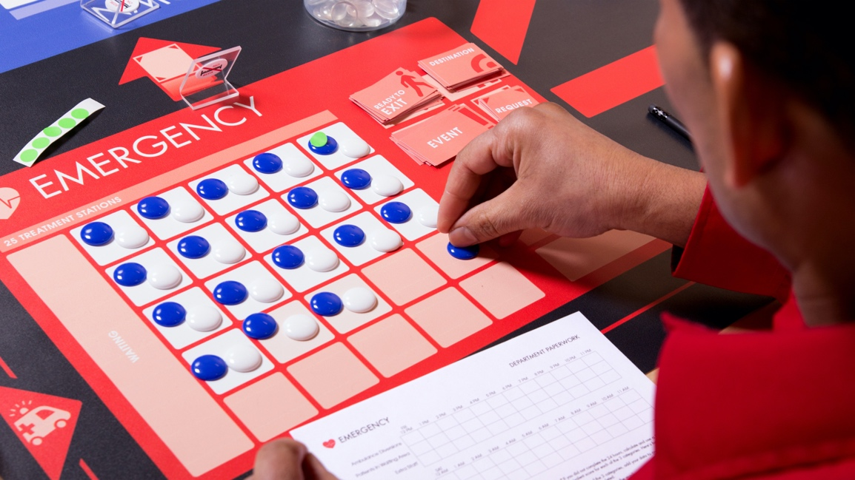
Some elements of structure in the game
Your role
Physical boundaries
Department paperwork
Your mental models
Notes:
The axiom “structure produces behavior” was also demonstrated in the game play.
Examples [CLICK through]
the assigned roles of players as “department managers” and their position in front of boxed areas on the game board—which may have led to a sense of primary responsibility to the department rather than the system
the accounting process with activity recorded by department—which again may have led players to be concerned that their departmental performance was most important (rather than system performance).
You earlier provided ideas about what drove your behavior in the game play, and they too were “elements of structure,” but often the most powerful drivers of behavior are not so evident or visible to people as they go about day-to-day work.

Slide 53
Here are some common elements of structure in organizations
Physical layout and environment
Performance measures
Reward systems
Information availability and visibility
Formal policies and procedures
Informal practices, cultural norms
Mental models
Notes:
[CLICK through these, and perhaps offer one or two examples that participants can relate to,
for example,
“Information availability and visibility”
Even though we know that data should drive our decision-making, maybe we don’t have the data we need, or it’s buried and not easily visible.
For example, do we measure various wait times and delays, and if we do, do we post a run chart of key wait times that everyone can see?
Do we know what actions have the greatest impact on reducing wait times?
Any and all of these are operative elements of structure in our organization that powerfully influence people – their expectations, their mental models, their ability to perform.

Slide 54
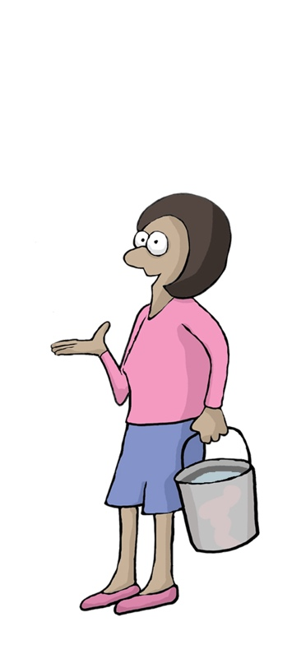
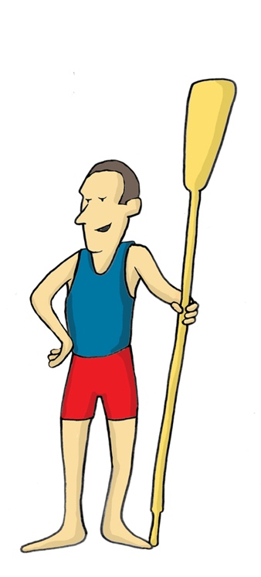
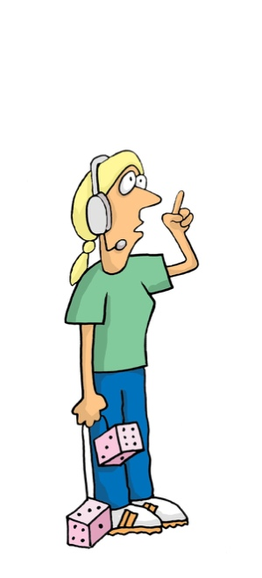
What do we do about this to get results?
So, if we want people to collaborate, innovate and be data-driven in our organization…
And if structure produces behavior…
Notes:
[CLICK through these to lead to the question]
Answer: There is a quick and easy way to home in on the key elements of structure that promote (or unintentionally inhibit) the behaviors we want to produce.

Slide 55
Simplest tool to identify structure is the
Structure Analyzer
Let’s demonstrate…
Notes:
The tool, the Structure Analyzer, is quick and simple and it’s especially productive when used with mixed groups.

Slide 56
COLLABORATION
1) State the desired behavior
Structure Analyzer
3) List forces that inhibit the behavior
2) List forces that drive the behavior
DRIVING
INHIBITING
Need to coordinate hand-offs between departments
Our leadership tells us to be a team player
..
We compete for budget resources
Emphasis on specialized functions and roles
..
Notes:
Here’s an example that shows how this tool works.
[CLICK]
1) At the top of a page – a flip chart, for example – state the behavior you want to see in the organization. Let’s use Collaboration as an example.
[CLICK]
2) Consider what forces are present in the organization that drive this behavior. [CLICK through] These are forces actually in play today in the organization – NOT the forces that could drive Collaboration if they were present. The list should reflect the present reality.
[CLICK]
3) Next list the forces that often (unintentionally) inhibit the behavior, Collaboration. [CLICK through]
The process of using the Force Field tool is a group process – because the quality of the information gained depends on getting the perspective of multiple stakeholders in the organization.
And it starts as a brainstorm process, just listing the ideas that come up.
Once you have a list of both Drivers and Inhibitors, the group goes back to tighten up the list – consolidating duplicates, making sure statements are clear and concrete.
Then, finally, the group identifies which forces are probably the most powerful by rank ordering the top 1 or 2 on each side.

Slide 57
Try the Structure Analyzer
Transfer the learning:
Choose one of the three core strategies.
List the elements of structure (drivers and barriers) that produce results.
Circle the top two from each list.
Notes:
[Instruct your group to turn to the next page titled ”Seeing the Invisible”]
Let’s transfer the learning once again.
As a team, choose a desired organizational behavior (e.g., collaboration, innovation, data-driven decisions) [or you can assign a behavior to each team] and discuss the drivers and barriers that produce results.
Record all ideas contributed by the team and come to consensus about which two elements of structure from each list you believe have the most influence.
Let’s hear from each team. [Plan to have at least 5 minutes of group dialogue.]

Slide 58

Actions and Results
Opportunity for Action:
React
Events
Increased leverage
to
achieve results
Anticipate
and Adapt
Patterns/trends
Modify or Redesign
Structure
Examine, Transform
Mental Models
Notes:
If you can imagine this triangle as an iceberg, you could ask, where is the “water level” in our organization? In some organizations, [CLICK] people just see Events and spend all their time reacting to them.
[CLICK]
Most organizations act as they see trends over time, which enables people to anticipate change and adapt.
[CLICK]
The greater leverage for achieving results is to work down at the more foundational, structural level.
[CLICK]
And to be able to transform the mental models that so powerfully influence behaviors, actions and decisions.
[CLICK]
As we are able to uncover more of the iceberg, we gain increased leverage to achieve desired results.
In today’s program you have experimented with working in all 4 levels.

Slide 59
Final Reflection
Personal
  What key insights did you gain from the simulation and debrief?
Organizational
  What important ideas surfaced that should be formally followed up?
Notes:
[Provide some way to close the program, and to indicate what follow-through the group can expect. You may ask participants to spend a minute before leaving and submit closing feedback, which will be compiled as a summary and distributed.]
Turn to the final page in your workbook and complete the reflection exercise.

